Slide 1



Team:Code warriors
Problem statement : Medical project

Slide 2
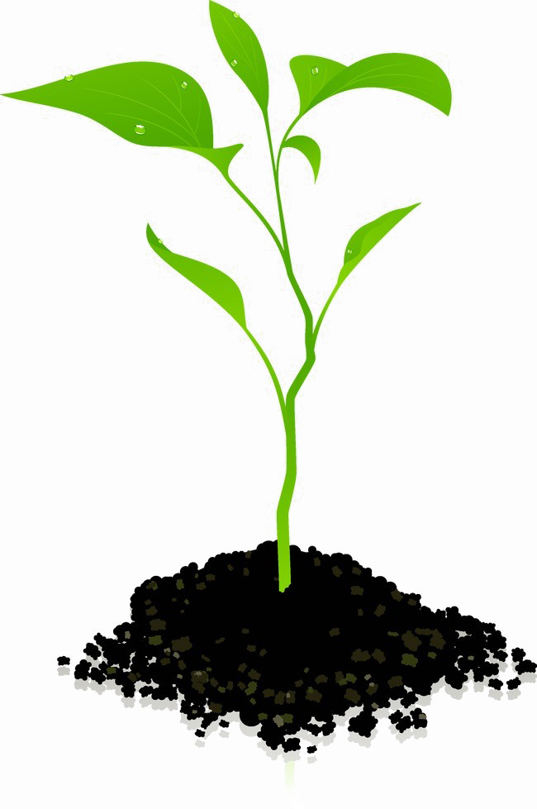
Problem Statement
The task is to create an AI-based application in the medical field that identifies plants from photos and provides information on their toxicity and medical uses. The solution involves building an AI model that accepts a photo of a plant and outputs the plant's name, its toxicity status, and its medical uses.

Slide 3
Solution we give
We are building an AI model that will take a photo of a plant and give the user its name, tell them if it is poisonous, and provide information on its medical uses.
User Interaction: The user interacts with the provided interface and inputs a photo of the plant.
Request Handling: The application accepts the user's request (photo input).
AI Model Processing:
Plant Identification: One AI model predicts the name of the plant from the photo.
Toxicity and Medical Uses: Another AI model takes the predicted plant name as input and predicts whether the plant is toxic and provides its medical uses.
Response Generation: The application responds with the name of the plant, its toxicity status, and its medical uses.

Slide 4


Ai/ml model use
Image prediction used
Toxicity prediction
Medical use prediction

Slide 5
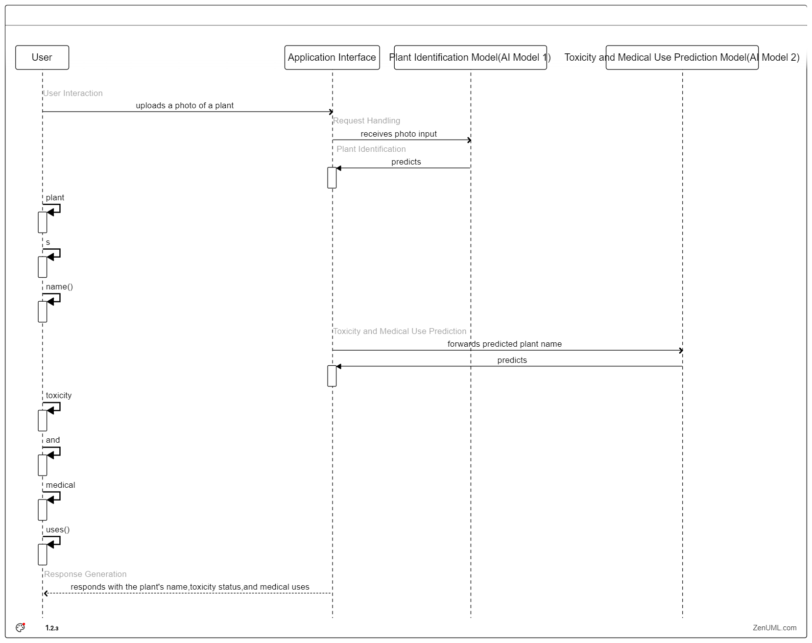
Sequence diagram

Slide 6
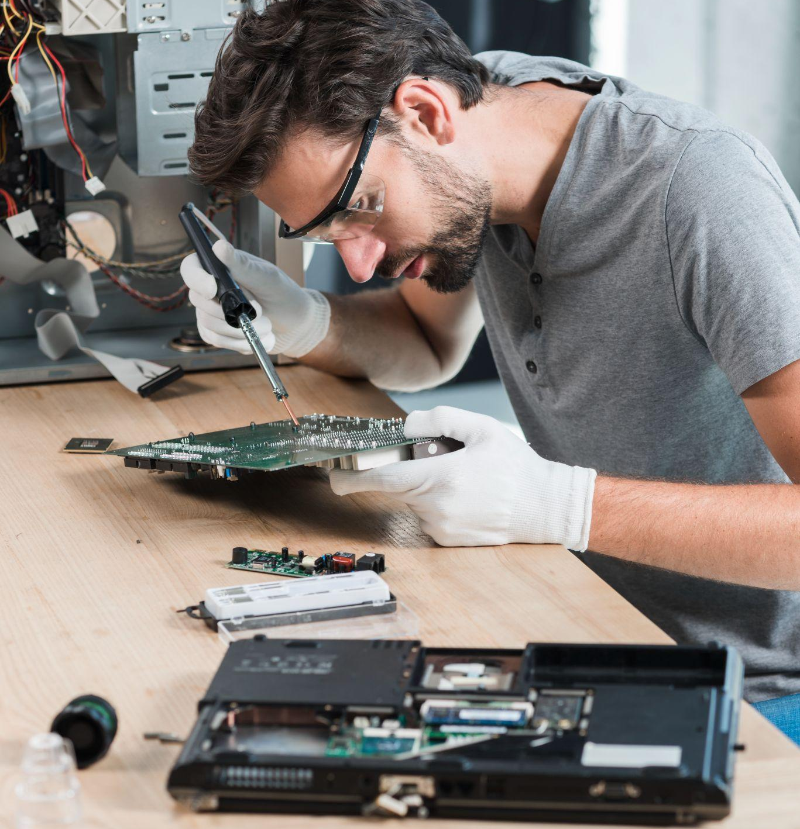
Let’s see the prototype

Slide 7
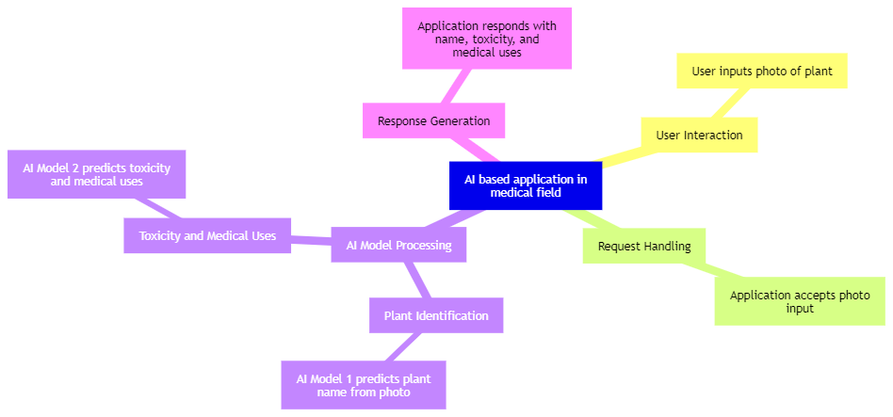
Mind map

Slide 8
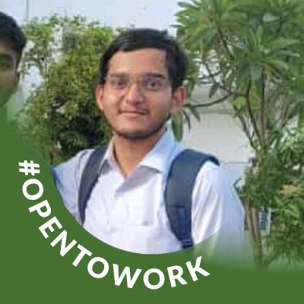
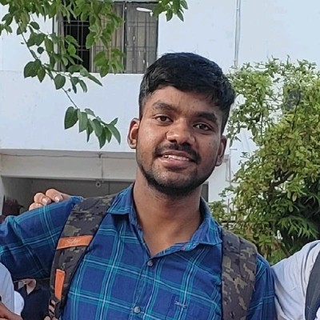

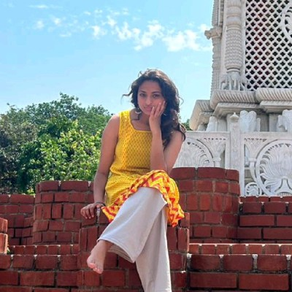
OUR TEAM
Praharsh Singh
Neeraj kumar
Anwesha bareja
Vishwas Patel
Linkedin
Linkedin
Linkedin
Linkedin

Slide 9
THANKS!

